Slide 1
Rregullimi i imazheve
TIK 12 – Prof. Blerand Koshi

Slide 2
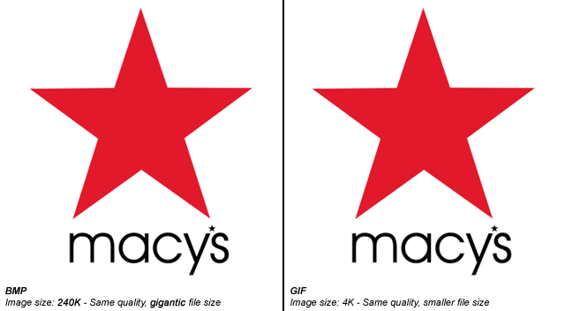
Imazhet

Slide 3
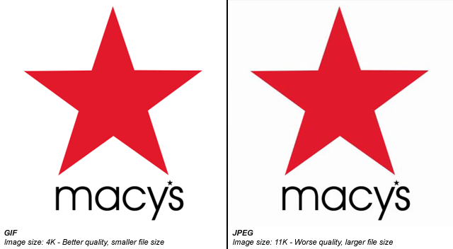
Imazhet

Slide 4
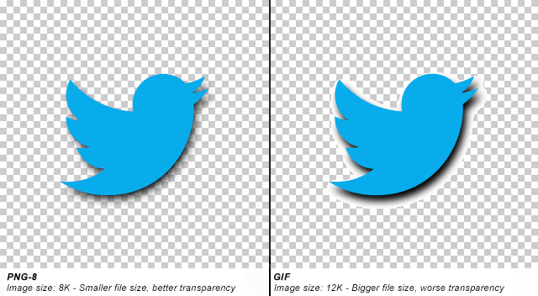
Imazhet

Slide 5
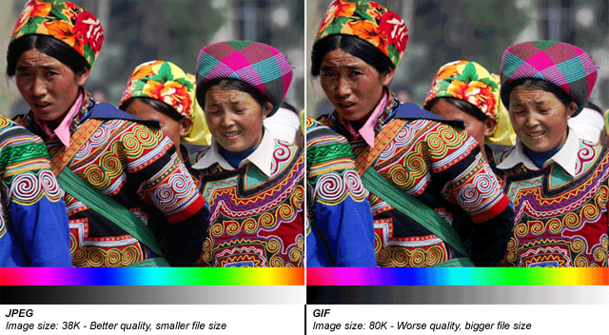
Imazhet

Slide 6
PNG, JPEG or GIF ?
PNG should be used when:
  You need transparency (either 1-bit or alpha transparency)
  Lossless compression will work well (such as for a chart or logo, or computer generated image)
JPEG should be used when:
  Lossless compression will not work well (such as a photograph)
  Full color is needed
GIF should be used when:
  PNG is not available, such as on very old software or browsers
  Animation is necessary

Slide 7
?
Pyetje

